Slide 1



Death By Iteration
Emmanuel Odunlade
Hardware Chapter Manager | Solutions Architect
: /emmanuel-odunlade/
: @emmaodunlade

Slide 2

Contents
Making Hardware Harder
Familiar Pains: Change Propagation
Avoiding Change loops with DSM
Evaluating Alternatives: Radar Chart and WDM
Future-Proofing Decisions with Sensitivity Analysis
: /emmanuel-odunlade/
: @emmaodunlade
Notes:
Iteration provides a path for fix mistakes and rapidly improve our product but without control, it could lead to inefficiencies that becomes clogs in the wheel of teams. Especially for hardware, because of it’s inherently waterfall nature and for resource constrained teams as it could mean they spend more time firefighting rather than innovation. So for today I will be sharing how some system architecture tools, and their lightweight implementation, very important, can be used to optimize the development process. So at the end of this talk i’m hoping to have picked your interest about this tools, but more importantly stir up your thoughts about the need for efficiency and optimization of your development process.

Slide 3
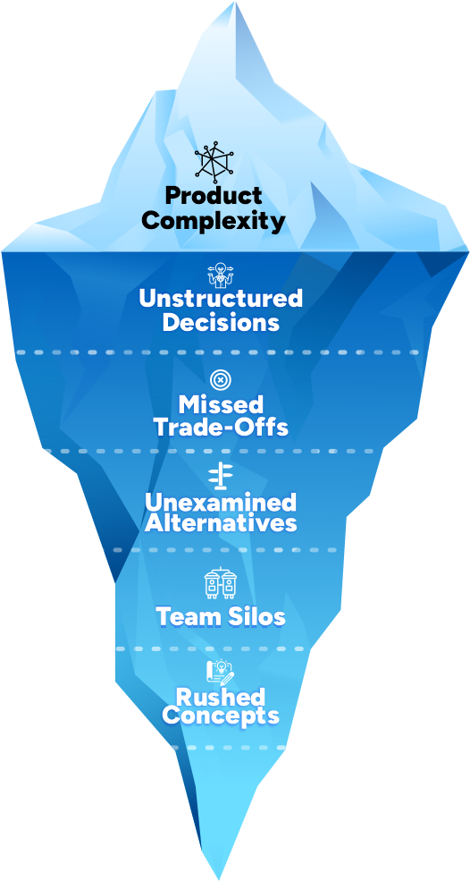
Making Hardware Harder
Architecting the System - but not the design Journey
Systems thinking and tools not being applied downstream
Org-wide frameworks are bulky, so teams abandon them
Notes:
So we usually chuck all the issues with hardware development to the fact the hardware is hard mantra. Which is very much true but everytime i conduct a post mortem or lessons learned analysis at the end of a development cycle it usually boils down some of this which can all probably be over simplified as a problem with decisions. So maybe if we make more structured decisions, conduct efficient tradeoff analysis we can increase the chances of getting it right more often, and thats where this tools come in. .Now this tools are nothing really novel about tis tools, if you work in industries where complexity is inherent like aerospace or automotive theres a chance that you’ve used them before but the problem is that

Slide 4
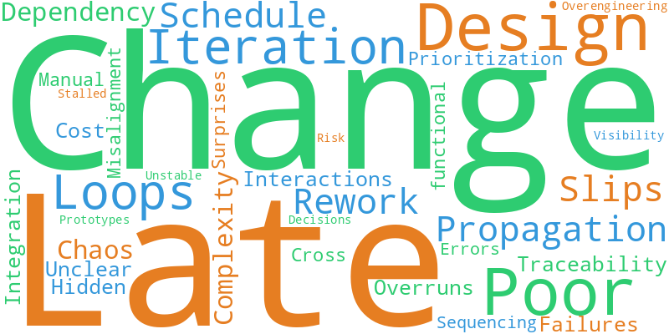
Familiar Pain: Change Propagation
Challenges of Change Management:
Increasing complexity
Multidisciplinary integration
Feature roadmaps often ignore interdependencies.
Change in one module ripples unpredictably.
Endless iteration loops drain time, money, and morale.
Notes:
The need for this tools and optimization is more important these days because our products are more complex than they used to be.

Slide 5
The Symbiotic three
Design Structure Matrix
Tradeoff Studies: Radar and WDM
Sensitivity Analysis
Notes:
So for today’s talk I will be spotlighting tools for the various stages of change propagation and building anything. One tool to ensure you are making the right decisions before the design journey, some tools to use during the design itself and one tool to ensure you stay happy after the design process.
So design structure matrix to decompose your architecture, fine tune your backlog etc, Radar chart and WDM, as tools to Sensitivity Analysis to validate the robustness of the decisions made during the design process.

Slide 6
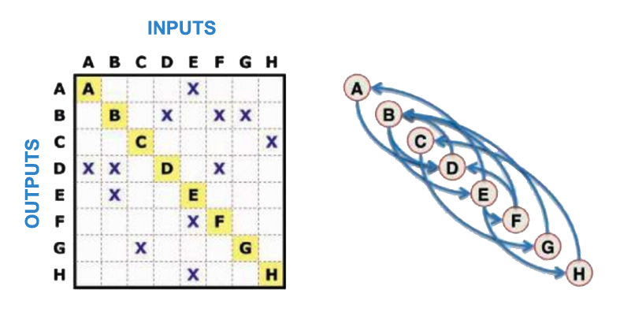
Optimizing Development Path with Design Structure Matrix
What is DSM?
Square Matrix-based tool for managing complexity.
Maps out system elements and their interactions.
Provides a compact, structured way to capture relationships between components.
Help teams break down and visualize dependencies.
Notes:
DSM - Design Structure Matrix also sometimes referred to as dependency structure matrix is a complexity management tool that is used In systems architecture to map out the interdependencies and interactions between systems element and components. Represented as an NxN matrix where N is the number of elements/components of that system, it provides a structured, and compact, simplified and straightforward way to capture relationships and visualize dependencies By looking at a DSM alone, a designer can distinguish relationship patterns of particular interest. For example, a DSM may show regions of heavy interactions indicative of assigning particular components to a module. Each row and column represents an element—this could be subsystems, teams, or tasks. An X shows a dependency. The goal is to find cycles, cluster tightly related items, and eliminate unnecessary entanglement.

Slide 7
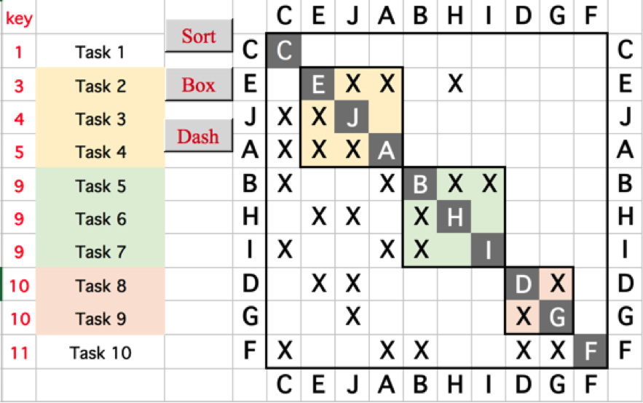
Optimizing Development Path with Design Structure Matrix
Why DSM?
Optimize development sequences
Streamline development process
Balance users & business needs
Reduce unnecessary iterations
Make informed decisions
Clarify Interfaces
Notes:
Product management has done this extensive work to determine what changes the product need and in what order they are to be delivered and hardware team has created tasks that leads to the delivery of those features, but hold on, what if two of those features are mutually exclusive. What if by PM wanting to deliver a new plastic first instead of fixing the increasing the speed of a motor that could lead to….the goal of DSM is usually to highlight circular dependencies, change propagation paths and get teams talking on design drivers early.

Slide 8
How to DSM
Ex.
Identify the system elements ( tasks, deliverables, features, interfaces).
Construct the initial matrix.
Populate dependencies based on stakeholder and expert opinion.
Sort the matrix to expose feedback loops.
Cluster tightly coupled elements into modules to identify tasks that are best done together - Use algorithms like Ward’s Method or PAM (Partition around medoids - more suitable for hardware)
The list below represents changes and new features that a team building a Next Gen Industrial Controller needs to implement;
Increase processing speed
Broaden wireless frequency support
Redesign power system for new battery standard
Improve thermal and mechanical performance of the enclosure
Adjusting the firmware to support enhanced real-time processing
Notes:
Goal of sorting is to rearrange the order of implementation to figure out which of the tasks should be done first, which of the tasks are better done together and which of the tasks is dependent on everything else and is probably best done last.

Slide 9
Change ↓ vs Dep → | Processing Speed (MCU) | Wireless Support | Power System | Enclosure | Firmware
Processing Speed (MCU) |  | X | X |  | X
Wireless Support | X |  | X |  | X
Power System | X | X |  | X | X
Enclosure |  |  | X
Firmware | X | X | X
X = Interaction exists (e.g., firmware must adapt to new MCU and wireless)
Notes:
Quick review of this will show how tools like DSM allows teams to frontload design drivers and have conversations about dependencies to set design

Slide 10
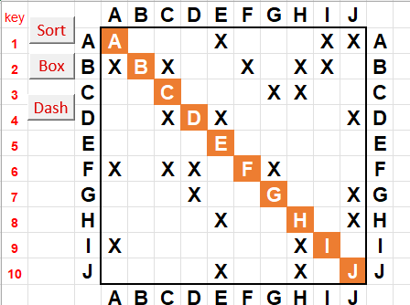
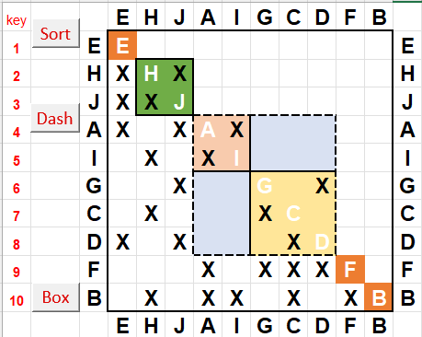
Sequencing with Process DSM
Based on DSM analysis: J&H | G,C,&D | A&I, are better done together. A&I can be done in parallel to G,C,&D

Slide 11
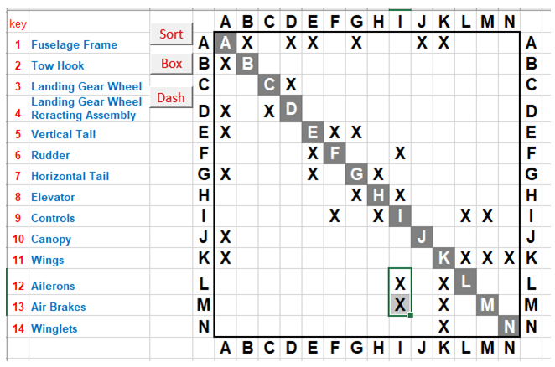
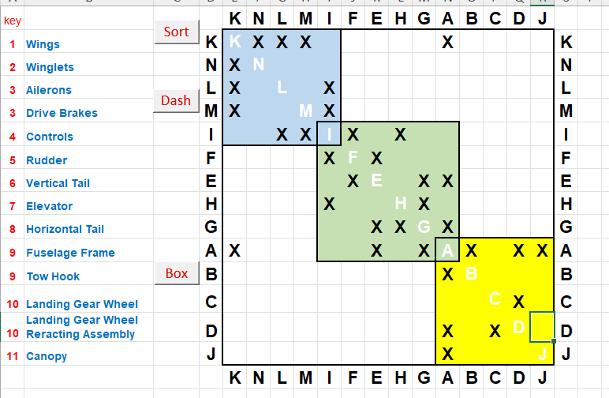
Value of Clustering - Glider Example
Before Clustering
After Clustering
Notes:
Clustering helps you group together changes that are tightly related and are probably best done together or at least considered together during implementation. It also reflects missed architecture relationships. .

Slide 12
Tradeoff Studies
Radar Chart
Weighted
Decision
Matrix
Notes:
So one of the reasons why teams don’t really do tradeoff analysis is because of the complexity of the tools vs the value/problem. Before you implement DOE and models etc. time and efforts against the reward just stops to make sense at some point. So we end up usually doing them for the “big things” and just play it by ear for small things, and just like bile in meat the small things messes everything up. A good example is selecting a framework for a project, i’ve seen people just go with what the team is familiar assuming without an actual analysis that it will take time for their team to get up to speed on the other framework and 3 months down the line the team is still stuck writing libraries that comes standard with the rejected framework. There tons of options for quick, lean tradeoff analysis but for this talk we will look at two tools i absolutely love, Radar chart and WDM. Two tools that are usually disrespected because of their simplicity.

Slide 13
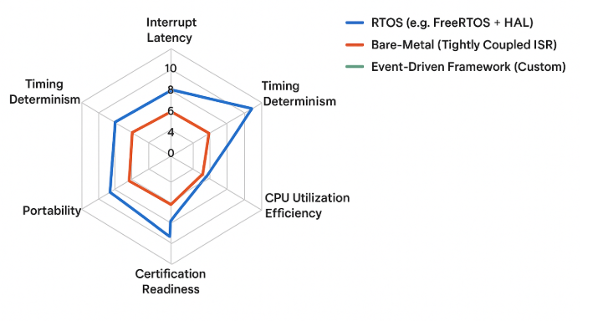
Evaluating alternatives: Radar Chart
How:
Define evaluation criteria (e.g., Boot Time, Power Efficiency, Flash Footprint, Maintainability, Feature Coverage).
Normalize scores (e.g., 0–10 scale or % of target).
Plot components being compared against their attributes on the same chart.
The larger and more balanced the polygon, the better the overall trade-off.
What? visualizing multivariate data using a circular display with axes radiating from a central point. It compares multiple quantitative variables by plotting their values as points on spokes and connecting them to form a star-like shape
Why?
Simplifies multi-criteria decision-making.
Highlights imbalances (e.g., great performance but poor maintainability).
Facilitates cross-functional discussions between firmware, hardware, and product teams.
Makes trade-off reasoning visual and defensible essential for design reviews or management decisions.
Notes:
Everytime I’ve spoken to someone about weighted decision matrix, there is usually that look of this is very basic and easy - Exactly so use it more! Everytime I’ve spoken to someone about weighted decision matrix, there is usually that look of this is very basic and easy - Exactly so use it more! And one of its best application that i have seen is in business value ranking for change management. So you have figured out the clusters you wanted to implement. Weighted decision matrix are useful for several things, but my favorite application when it comes to change/backlog management or just general product development, is figuring out business value. In a time and other resource constrained world, where its probably going to take you 3 months to get your product out, the last thing you want to do is spend time on features, or hardware issues that are not cogent. Other applications of weighted decision matrix and tradeoff studies

Slide 14
Radar Chart Example
Attribute | Description | Scoring Basis (0–10)
Interrupt Latency | Average response time to ISR triggers | Lower = Higher score
Timing Determinism | Jitter and repeatability under load | Lower jitter = Higher
CPU Utilization Efficiency | Ability to utilize available MIPS without overhead | Higher = Better
Scalability | Ease of integrating new tasks/modules | Higher = Better
Portability | Ease of porting to different MCUs/architectures | Higher = Better
Certification Readiness | Alignment with safety/functional standards (e.g., ISO 26262, IEC 61508) | Higher = Better
Evaluating Firmware Architectures for a Sensor Hub MCU
Criteria | Interrupt Latency | Timing Determinism | CPU Utilization Efficiency | Scalability | Portability | Certification Readiness
RTOS | 7 | 8 | 7 | 9 | 9 | 8
Bare-Metal | 10 | 10 | 9 | 5 | 6 | 4
Custom | 8 | 9 | 9 | 8 | 8 | 9

Slide 15
Radar Chart Example

Slide 16
Evaluating alternatives: Weighted Decision Matrix
What?
A structured tool used to compare design options against multiple criteria by assigning weights to each criterion based on importance.
How:
List design options
Define decision criteria (e.g., cost, power, time-to-market, reliability)
Assign weight to each criterion based on importance - total - 100% or 1
Score each option per criterion
Multiply scores by weights and sum total
The option with the highest total weighted score is typically the most favorable.
Why?
Brings objectivity to complex tradeoffs
Aligns team around data not opinions
Helps teams agree on priorities
Reduces bias in decision-making
Visualizes the best-fit option based on weighted scores
Option | Cost (30%) | Power (20%) | Reliability (30%) | Time (20%) | Total
A | 8 × 0.3 = 2.4 | 7 × 0.2 = 1.4 | 6 × 0.3 = 1.8 | 9 × 0.2 = 1.8 | 7.4
B | 6 × 0.3 = 1.8 | 9 × 0.2 = 1.8 | 8 × 0.3 = 2.4 | 5 × 0.2 = 1.0 | 7.0
Notes:
So one of the reasons why teams don’t really do tradeoff analysis is because of the complexity of the tools vs the value, problem. Before you implement DOE and models etc. time vs efforts ration stops to make sense. Everytime I’ve spoken to someone about weighted decision matrix, there is usually that look of this is very basic and easy - Exactly so use it more! Everytime I’ve spoken to someone about weighted decision matrix, there is usually that look of this is very basic and easy - Exactly so use it more! And one of its best application that i have seen is in business value ranking for change management. So you have figured out the clusters you wanted to implement. Weighted decision matrix are useful for several things, but my favorite application when it comes to change/backlog management or just general product development, is figuring out business value. In a time and other resource constrained world, where its probably going to take you 3 months to get your product out, the last thing you want to do is spend time on features, or hardware issues that are not cogent. Other applications of weighted decision matrix and tradeoff studies

Slide 17
WDM For Value
Analysis of DSM Clusters
Value Dimensions
Dimension | Description | Weight (%)
Revenue Impact | Potential to drive revenue growth | 25%
Cost Reduction | Potential to lower operational or product costs | 15%
Risk Mitigation | Helps reduce current or future risks | 10%
Strategic Alignment | Fits closely with goals and long-term strategy | 20%
User Value/Uptake | Boosts user growth, adoption, or satisfaction | 30%
Value Score =
(Weighted Sum) × DSM Dependency Density
WSJF or ROI =
Value Score / Effort
Cluster ID | Revenue | Cost | Risk | Strategy | Customer | DSM | Effort | Value Score | WSJF | Rank
A | 4 | 4 | 5 | 5 | 4 | 4 | 5 | 17.2 | 3.44 | 1
B | 3 | 3 | 4 | 4 | 5 | 3 | 4 | 11.7 | 2.93 | 2
C | 3 | 3 | 4 | 4 | 5 | 2 | 3 | 7.8 | 2.60 | 3

Slide 18
Future Proofing Decisions:
Sensitivity Analysis

Slide 19
Sensitivity Analysis
What?
A technique used to test how changes in inputs (e.g., weights, scores, priorities) affect the outcome of a decision model like a Weighted Decision Matrix.
How:
List design options
Define decision criteria (e.g., cost, power, time-to-market, reliability)
Assign weight to each criterion based on importance - total - 100% or 1
Score each option per criterion
Multiply scores by weights and sum total
The option with the highest total weighted score is typically the most favorable.
Why?
Ensures your decision holds up under different assumptions
Highlights which criteria or variables have the most influence
Helps justify your decision to stakeholders
Prepares you for shifting business conditions or priorities
Option | Original Score | Adjusted Score | Adjusted Rank
A | 7.4 | 7.4 | 1
B | 7.0 | 7.4 | 1
When the weight of "Power" was increased and "Cost" reduced, Option B’s score rose to match Option A. Demonstrating that preference can flip based on shifting design priorities.
Notes:
Not just the product, the world is in such a competitive environment that its so important to evaluate how sensitive the decisions we are making are to change in the factors that supports the decision. What happens if our cost factors change, will this still be the best set of features to work on, what happens if the strategy for the product becomes more important than the cost. Will this still be the best decision. What happens if our tariff increases with this current supplier will this still be the best thing to build….that is sensitivity analysis. Would you still be building the right thing if there is a shift in your value proposition.

Slide 20
Sensitivity Analysis of Cluster Business Value
Value Dimensions
Dimension | Description | Weight (%)
Revenue Impact | Potential to drive revenue growth | 25%
Cost Reduction | Potential to lower operational or product costs | 5%
Risk Mitigation | Helps reduce current or future risks | 10%
Strategic Alignment | Fits closely with goals and long-term strategy | 20%
User Value/Uptake | Boosts user growth, adoption, or satisfaction | 40%
Note the change in the weight of Cost, Risk and Customer. A stays 1st and should be prioritized.
Cluster ID | Revenue | Cost | Risk | Strategy | Customer | DSM | Effort | Value Score | WSJF | Rank
A | 4 | 4 | 5 | 5 | 4 | 4 | 5 | 17.2 | 3.44 | 1
B | 3 | 3 | 4 | 4 | 5 | 3 | 4 | 12.3 | 2.93 | 2
C | 3 | 3 | 4 | 4 | 5 | 2 | 3 | 8 | 2.60 | 3

Slide 21




Prioritization Under Uncertainty
Flexible
LED Color,
Connector
placement
Plan early
MCU, power
system,
key sensors
Prioritize with Intent
Low
Lock high-impact dependencies early
Keep Low-Coupling areas flexible
Coupling
Monitor
Secondary
sensors
Freeze early
Safety,
Architecture
Revisit Priorities at each integration stage
High
Always ask: Has anything changed upstream that invalidates our assumptions?
Low
High
Cost to change
Notes:
“One of the hardest realities for small teams is that you almost never have the full architecture locked before you start building. Parts are backordered, requirements shift, firmware is still being defined.
But there’s a practical way to deal with that — it’s not about freezing everything early, it’s about freezing the right things first.
Here’s how I approach it:
Lock high-impact dependencies early.
Anything that affects firmware interfaces, timing, or power behavior needs to be decided upfront — MCU family, power system topology, key sensors, and communication interfaces.
These are the things that, if they move, force rework across multiple domains.
Keep low-coupling areas flexible.
Cosmetic or mechanical details — LED color, connector position, housing geometry — can stay fluid longer. They’re unlikely to break builds or block firmware integration.
Revisit priorities at integration checkpoints.
Each time you integrate hardware and firmware, take 15 minutes to ask: ‘Has anything changed upstream that invalidates our assumptions?’
This lightweight reflection prevents small shifts from turning into big surprises.
This approach prevents paralysis — you’re still moving fast — but it focuses your energy on what’s most expensive to change.

Slide 22
Conclusion
Firefighting or Foresight…Choose your hard.
Curate feature roadmaps based on needs but order development based on dependency.
Design the design process as deliberately as the product. It’s worth it
“In God we trust, all else must bring data” - Align team and development around data not opinions
Use DSM and other systems engineering tools to reveal hidden loops and dependencies
Keep it Lean - Lightweight tools (spreadsheets and scripts)
Keep in mind sunk, and Opportunity Cost
Notes:
In conclusion, a few words to live by; one thing i usually hear is Emmanuel Even though this is a dumb down, simplified version, it’s still going to take time implement, time away from development, and My response is usually yeah…..but consider this, the rework, realignment etc, will take even more time. Choose your hard. We will all agree that open source firmware is something that is already resource constrained, so much that it might be better to not lose time to inefficiencies. Think about it this way: every blind choice we make risks adding sunk cost — time and effort that will never be recovered. Every time we prevent one of those, we preserve opportunity — the chance to deliver features faster, or spend effort on innovation instead of firefighting.
You may not be able to avoid every mistake but their is an increased chance of preventing the big ones.

Slide 23
Questions

Slide 24

DSM Resources
dsmweb.org
Notes:
Bsm.org is one of the living resources for how to integrate DS out how to do this involved information about the different types of DSM how to implement it and the community so so if you'd like to learn more about the SM and how to use it it's for checking out

Slide 25
Thank you for listening
Continue the Conversation? Reach out!
Notes:
Thanks again for joining. If this resonates with your experience—if you're scaling hardware under tight budgets, or building cross-functional clarity—I’d love to continue the conversation.

